Slide 1
Die-to-die interconnect

Slide 2
Motivation
D2D vs C2C
Signaling schemes
Trends
Ideas

Slide 3
Motivation
Yield
Chiplets

Slide 4
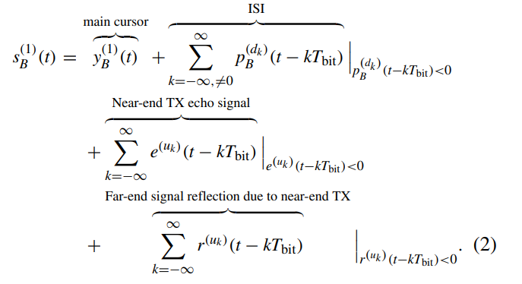
D2D vs. C2C
Insertion loss
Echo
Reflections
Crosstalk
Clocking
Equalization

Slide 5
Signaling schemes
Differential vs. single-ended
PAM4 vs. NRZ
Unidirectional vs. simultaneous bidirectional

Slide 6
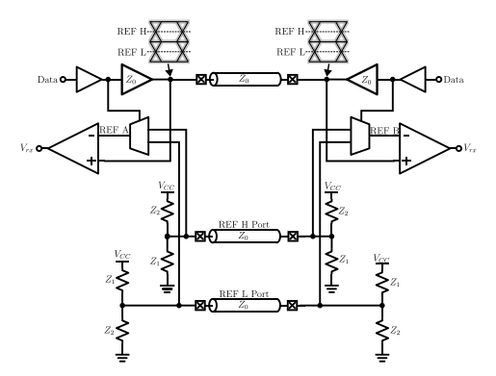
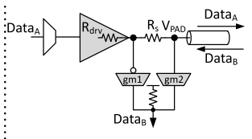
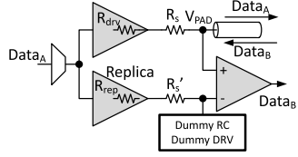
Trends
Dynamic reference switching
  Delay matching
  Kickback noise
  Digital delay
R-gm
  Component matching and PVT
  Gm linearity
Replica driver
  Matching replica
  Power, area

Slide 7
Ideas
1) Pre-boot/adaptive replica driver tuning
  Send and sample a test signal
  Learn impedance properties of channel
  Adjust replica driver accordingly

Slide 8
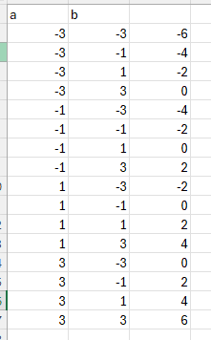
Ideas
2) SBD + PAM4
  PAM4 is useful for:
    Channel loss over 20 dB at one-half bit rate
    Channel discontinuity causing insertion loss notch
      Both mitigated using dense D2D and shorter channels, but some applications may still have long/lossy channels
  PAM4 pitfalls in D2D
    Amplitude, timing margin, linear drive impedance, linear amplifier, clocking

